Slide 1
How to resend an order to the vendor
Yoel Kortick
Senior Librarian

Slide 2

Agenda
Introduction
An example

Slide 3
Introduction

Slide 4
Introduction
In addition to this document also see Resending POs at Approving and Sending POs
For PO lines that have not been canceled and whose Acquisition method is Purchase, it is possible to resend the PO to the vendor by selecting Resend Order for the sent PO.
This option is useful when the order was successfully sent by Alma, but due to technical reasons on the vendor's side was not properly received or was lost.

Slide 5
An example

Slide 6
An example
Identify the PO (Purchase Order) of the POL (Purchase Order Line) which you want to resend.
It must be of acquisition type "purchase" and not have been canceled
On the next slide we have PO line POL-46714 (Sent) for title "AI techniques for renewable source integration and battery charging methods in electric vehicle applications"
This order was sent on Jan. 02, 2025, as part of Purchase Order PO-648713

Slide 7
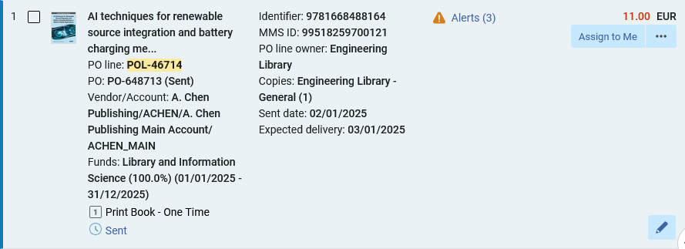
An example
Sent Jan. 02, 2025
In status "Sent"
POL-46714 was sent as part of PO-648713

Slide 8
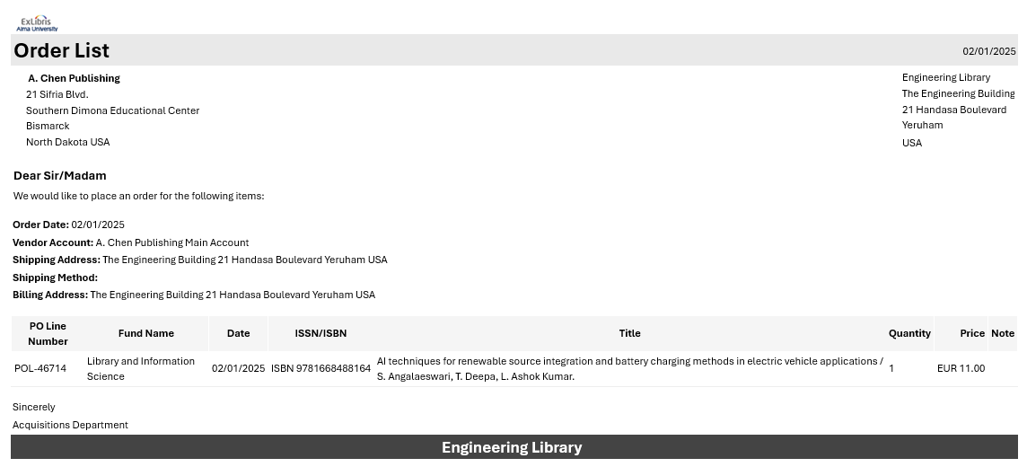
An example
The letter to the vendor was sent on Jan. 02, 2025, but the vender stated that it was not received.

Slide 9
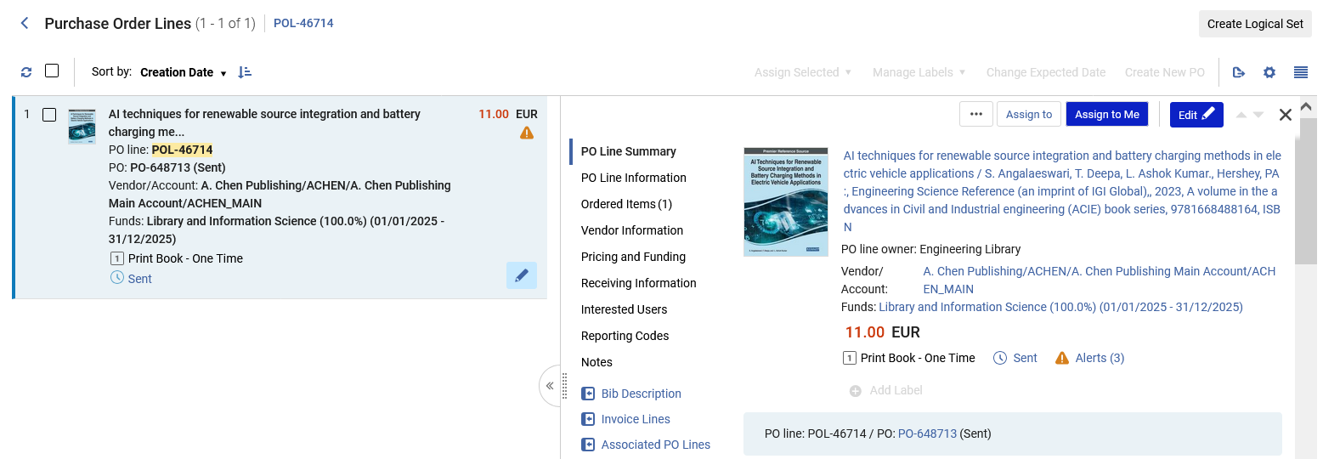
An example
Navigate to the PO by clicking the link to the PO
Click the link to the PO

Slide 10
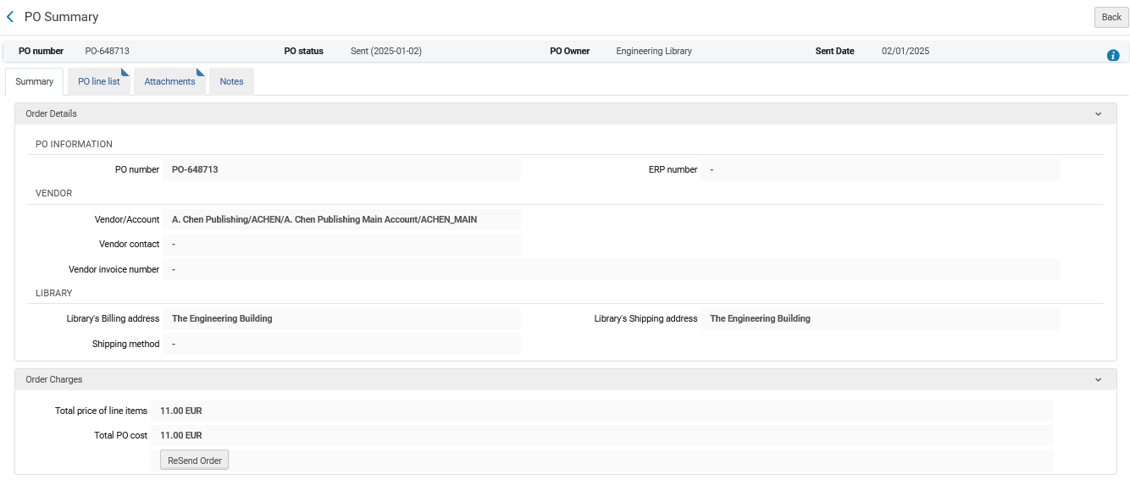
An example
Scroll to the bottom of the "Summary" of the PO and click "Resend Order"
Click here to resend the order

Slide 11
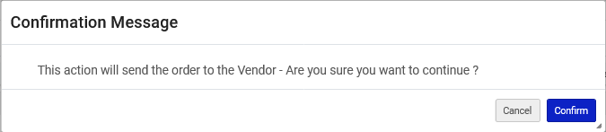
An example
Confirm the message

Slide 12
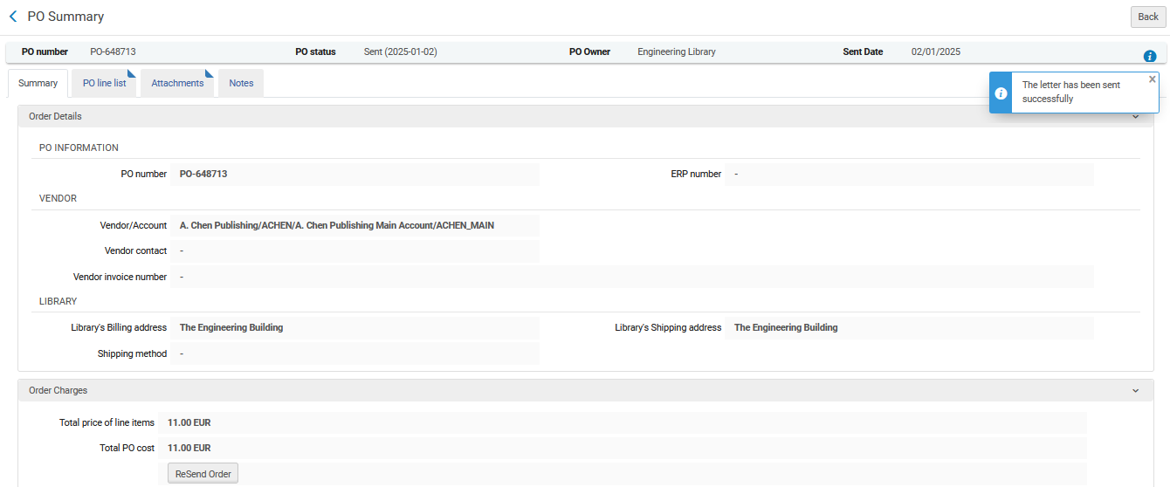
An example
Receive confirmation that the order has (again) been sent

Slide 13
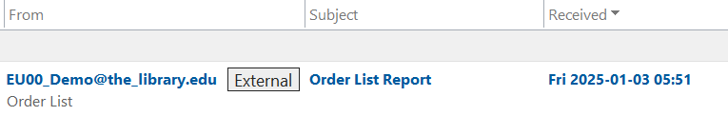
An example
The vendor receives the new email with the order.
This email with the order was sent Jan. 03, while the previous one was sent Jan. 02.

Slide 14
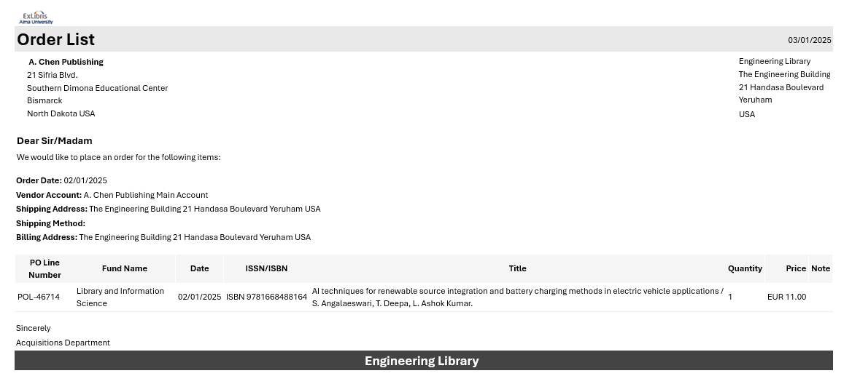
An example
This is the new email order to the vendor.
The date of the email is Jan. 03, 2025, but the "Order Date" is still Jan. 02, 2025 (when it was originally sent)

Slide 15
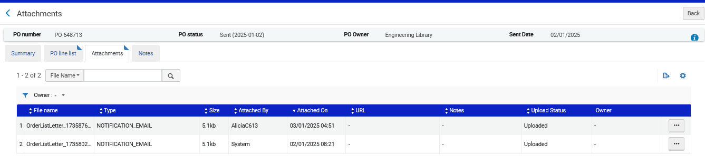
An example
We can see both letters in the attachments tab of the PO

Slide 16
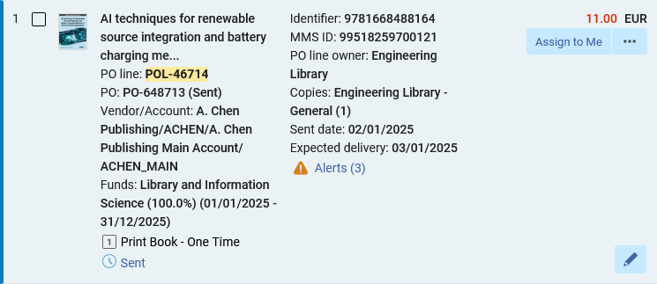
An example
In Alma, the "Sent Date" remains the date that the order was originally sent.

